Slide 2
MYiTOPS
ηNet
The cyber-physical and open source system
Ferhat Aslan

Slide 3
Workshop is divided into three blocks
Presentation and Discussion
Group Work and Presentation of the Results
Practical Introduction to Github and ηNet
06.11.17
| 3

Slide 4

Definition of Digitalisation
The conversion of text, pictures, or sound into a digital form that can be processed by a computer.
Example:
‘Analysis and digitization of the signals provides a greatly improved and clearly defined image.’
‘Measurements were performed off-line using a computer-assisted digitization system.’

Slide 5





Definition of Digitalisation
… is the process of converting information into a digital (i.e. computer-readable) format, in which the information is organized into bits… The result is called digital representation or, more specifically, a digital image, for the object…
Information of the Cat…
“Real World”
Object
“Digital World”
Object
Converting…
Notes:
The Digit-Cat can used to understand Cats, the e-book can used to read the content!

Slide 6


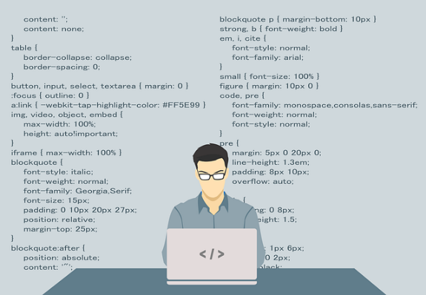
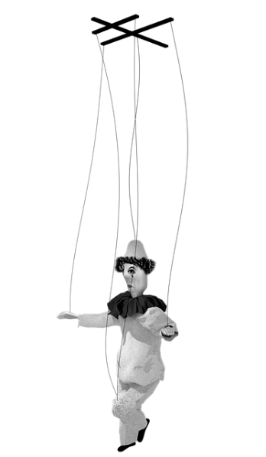

Acquisition and Control of the Real Object via the Digital Object
“Digital World”
Object
Converting…
Management
“Real World”
Object

Slide 7
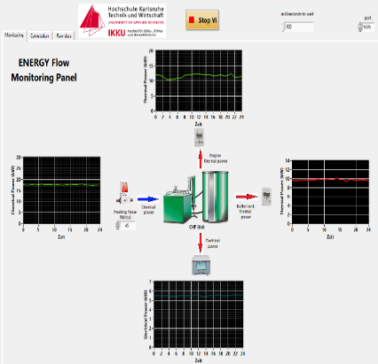
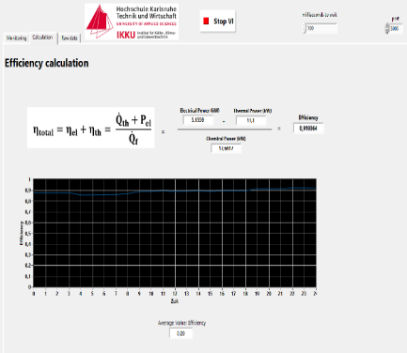

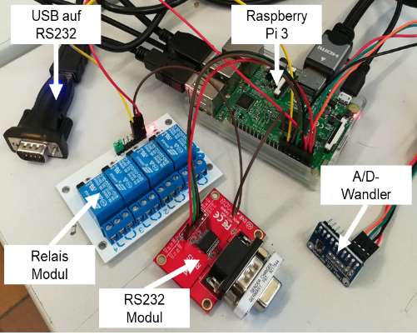
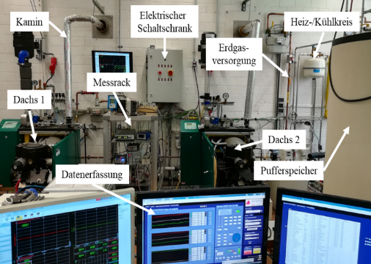
Digitisation of Test Benches?
“Digital World” Object(s)
Management
Converting…
“Real World” Object(s)
06.11.17
| 13

Slide 8
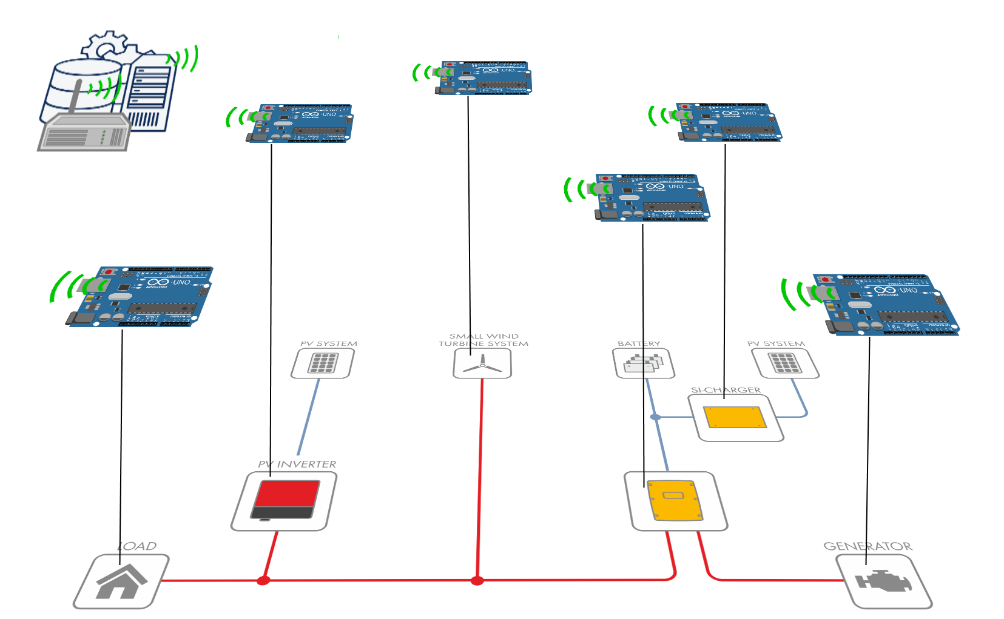
Digitisation of (Energy) Systems?
Cyber-physical Systems!
Combination of computer and software components with mechanics and/or electronics as well as networking of the components with each other.
Digital Image or
Digital Abstractions
of the Energy System
Cyber-physical
Objects (CPOs)
Infrastructure of
Regulation of
energy flows
Definition: Arbeitskreis Industrie 4.0
Quelle: Fraunhofer IESE, iese.fraunhofer.de/de/innovation_trends/industrie4_0.html, SMA.de
06.11.17
| 8

Slide 9
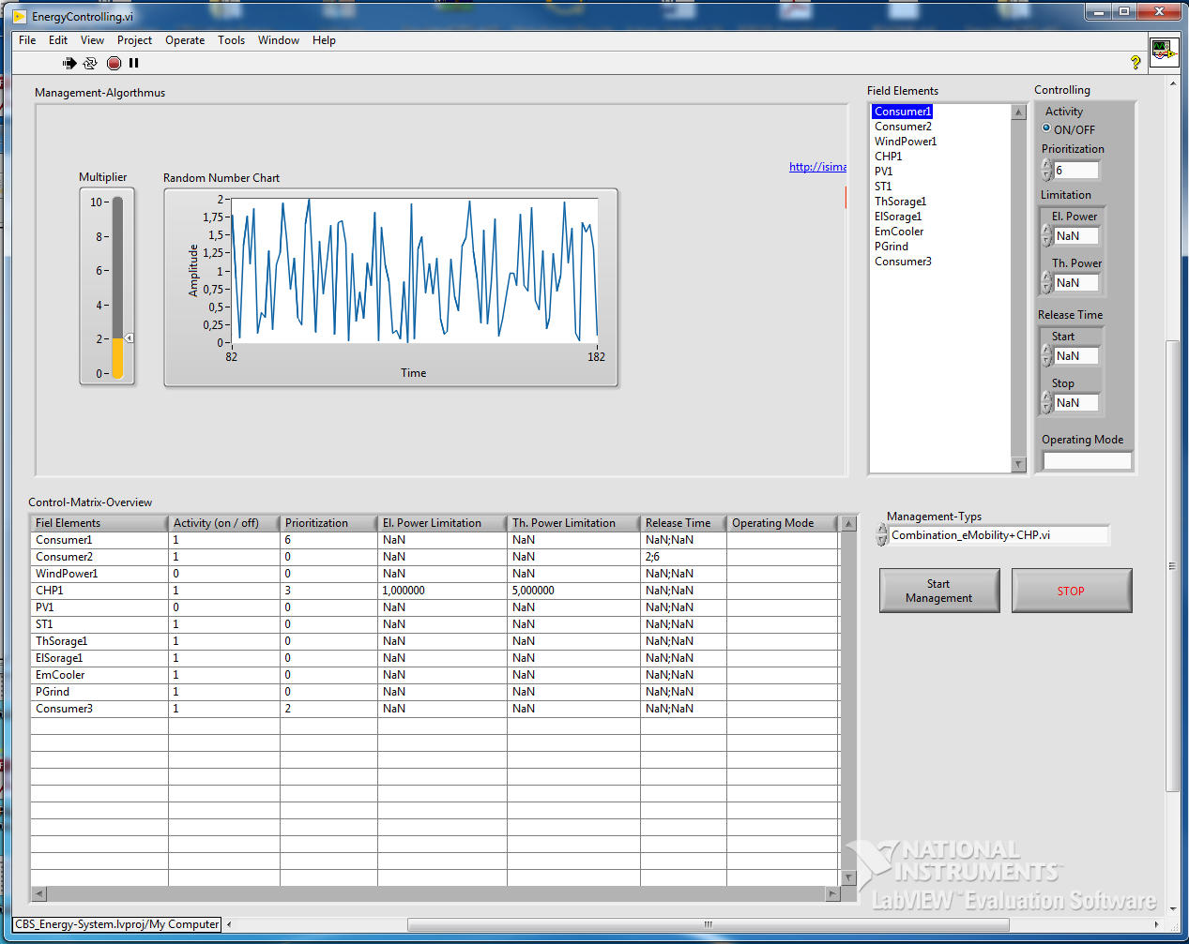

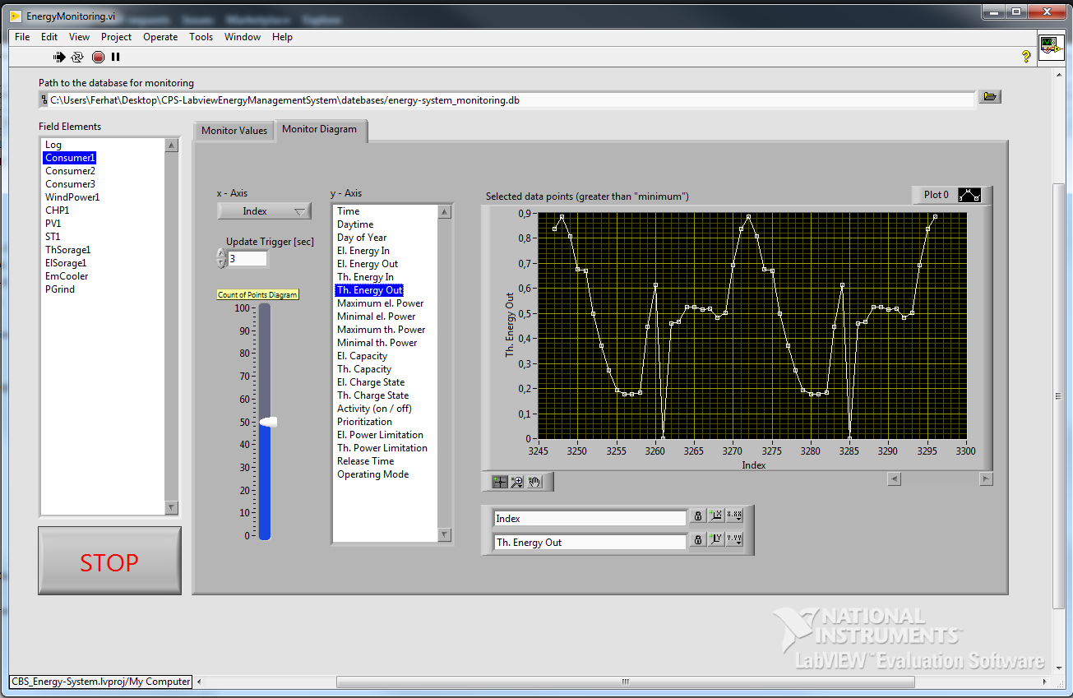
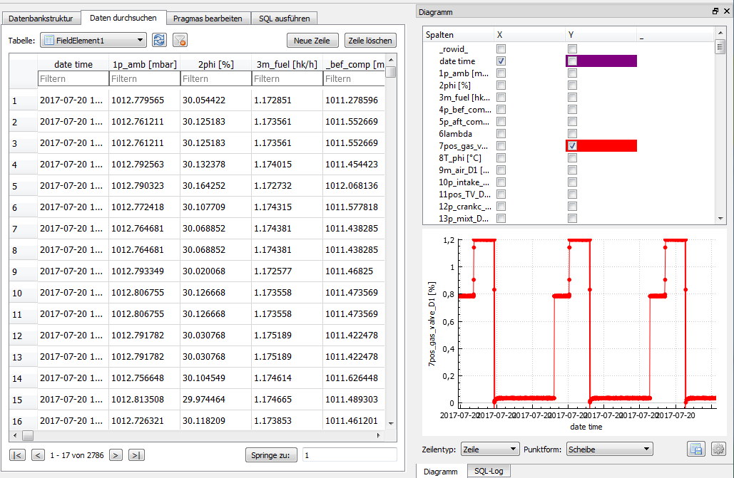


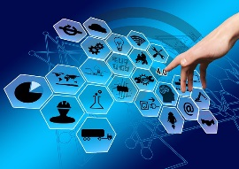

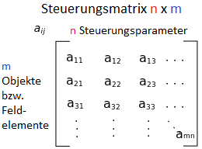
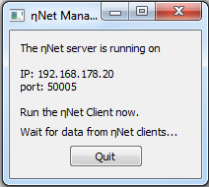
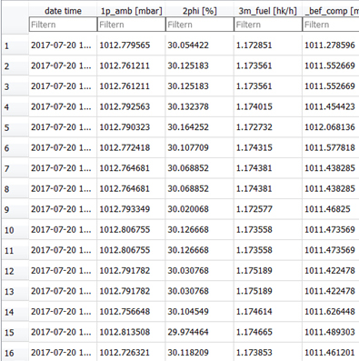


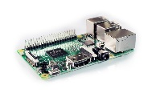
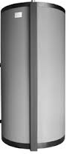


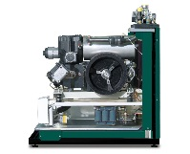
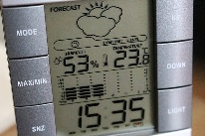
OOP-oriented Programming Paradigm
Management Interface
Monitoring
Abstraktion und Digitalisierung der Anlage
Schnittstelle für die Managementschicht und der CPOs
Handler
Data Collector
Projekt MYiTOPS (gefördert von BWS plus mit 110 000 Euro)
Doppelabschluss-programme (Bachelor)
Cyber-Physical Objects
Producer
Consumer
Storage

Slide 10
Opens different possibilities:
Design of the visualization and usability of energy flows of combined heat and power units (CHPs) on a touch screen.
Integration of weather data
Conception of the management of BHKWs for the eMobility (charging station)
Development and integration of an electrical storage device
Control of test benches and energy systems via the Internet

Slide 11
Why Cyber-physical Systems?
They enable the control and monitoring of complex systems and infrastructures.
What is meant by industrial revolution?
What advantages are expected in industry?
How can we use it for our goals?
Notes:
Tafel -> saving time, location-independent cooperation, project management, Monitoring development, Coordination of tasks, Scientific added value

Slide 12
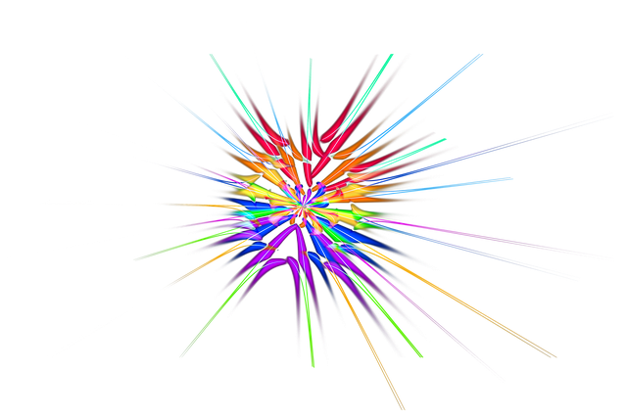



How can we work together in the future?

Slide 13
What is GitHub?
It lets you and others work together on projects from anywhere.
What do I have to do to use GitHub?
When would you want to learn it?
What can I do?
Notes:
Tafel -> saving time, location-independent cooperation, project management, Monitoring development, Coordination of tasks, Scientific added value

Slide 14

Software Publications
https://github.com/IKKUengine/SimulatedCPSLabVIEWEnergySystem (LabVIEW)
https://github.com/IKKUengine/CHPefficiency (Python)
Will follow soon:
https://github.com/IKKUengine/SingleServerCHPefficiency (LabVIEW)
https://github.com/IKKUengine/ThreadedEtaNetServer (C++/Qt5.8)
https://github.com/IKKUengine/CPOEtaNetClient (C++/Qt5.8)
GitHub.com/ikkuengine

Slide 15
Dankeschön…
Contact
Ferhat Aslan
Institut für Kälte-, Klima- und Umwelttechnik
Tel.: 0721 925-1815
Raum M-U07
E-Mail: ferhat.aslan@hs-karlsruhe.de
Prof. Dr.-Ing. Maurice Kettner
Fakultät für Maschinenbau und Mechatronik
Tel.: 0721 925-1845
Raum F-111
E-Mail: maurice.kettner@hs-karlsruhe.de

